Slide 1

Business Process Modelling -7.2/2012 -
Marcello La Rosa
Queensland University of Technology
Brisbane, 5 September 2013

Slide 2

Quick Repeat from Week 6
What’s BPMN’s context and main goal?
What are the main differences between BPMN and EPCs?
How can we represent data objects and resources in a BPMN model?

Slide 3
Assignment 1 common mistakes: Process Model
Generally good quality models, but:
Missing labels on (X)OR-split conditions, message flows, start/end events
Two actions in one task (e.g. “Ship goods and invoice customer”) – decompose into 2 tasks instead
Too low level tasks such as “click X button” or “continue to X page on website” – aggregate when performed by same resource (e.g. “Fill out form”)
Normal sequence flow crossing pools’ boundaries

Slide 4
Assignment 1 common mistakes: Process Model
Modelling “without knowing”:
You are only required to use the elements we have explained before the deadline. If you venture yourself into advanced BPMN elements which we haven’t explained, you will still be marked if these are used improperly.
Our advice: don’t venture yourself into new stuff.

Slide 5
Assignment 1 common mistakes: Format/Presentation
Most marks lost in format/presentation: the textual documentation is meant to help understand the process models. Do not undervalue its importance and be diligent:
Refer to diagram labels in textual description, e.g. “Figure 1 below shows the high-level process model of xxx”
Use abbreviations consistently – BPM for Business Process Management, not for Business Process Modelling
Use professional language, do not shorten words: e.g. use “do not” instead of “don’t”
Present report structure succinctly in one paragraph in the Introduction before proceeding into core of report

Slide 6
Assignment 1 common mistakes: Format/Presentation
Process models must be included in body of report, NOT in appendices: appendices only used to provide additional (i.e. non-core) information
Appendices need to be referenced in body of report
Concepts, benefits and challenges need explanation – do not assume readers know what you mean, e.g. “standardisation of notation”, “model-driven process execution”
Ensure process models are readable – it is ok to have one process model per page (vertical) instead of squeezing 3 models in one page
Significance of process modelling not stressed enough
Notes:
Process models are the core of the assignment – appendices are meant to be used for additional information, which in this instance isn’t the case.

Slide 7
Agenda Today
Organisation of this Subject
Process Modelling
Foundations of process modelling: Petri Nets
Event-driven Process Chains (EPCs)
Business Process Model and Notation (BPMN 2.0)
Business Process Identification
Business Process Discovery Methods
Managing process modelling projects

Slide 8

BPMN Modelling - Advanced Concepts (Part I) -

Slide 9
How do we combine these?
What needs be done and when? - Control flow
What do we need to work on? – Data
Who’s doing the work? - Resources (human & non-human)
Notes:
Expand on active and passive resources, active resource types (human, systems, equipment), resource classes

Slide 10
Default flows
A default flow is the default branch to be chosen from an (X)OR-split if all other conditions evaluate to false
Avoids deadlocks if none of the conditions evaluates to true due to a modeller’s mistake
Is not necessarily the “most common choice”

Slide 11
Implicit vs. Explicit Control Flow Semantics

Slide 12
What is this process doing?

Slide 13
Process Decomposition
An activity in a process can be decomposed into a “sub-process”.
Use this feature to:
Break down large models into smaller ones, making them easier to understand and to explain
Identify parts of a process model that should be:
repeated
executed multiple times in parallel
cancelled, or
compensated.
Activities

Slide 14
Example: Sub-processes

Slide 15
Modelling process hierarchies with sub-processes
(Fragment of the SCOR reference model)

Slide 16
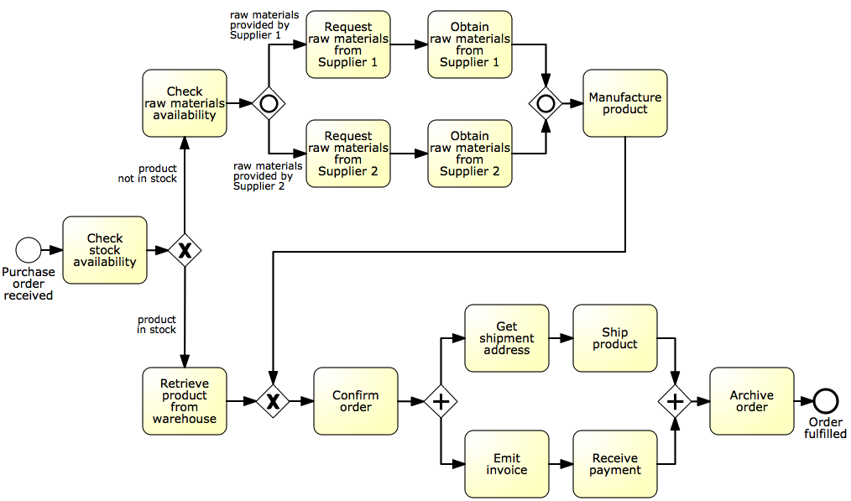
Identify possible sub-processes

Slide 17
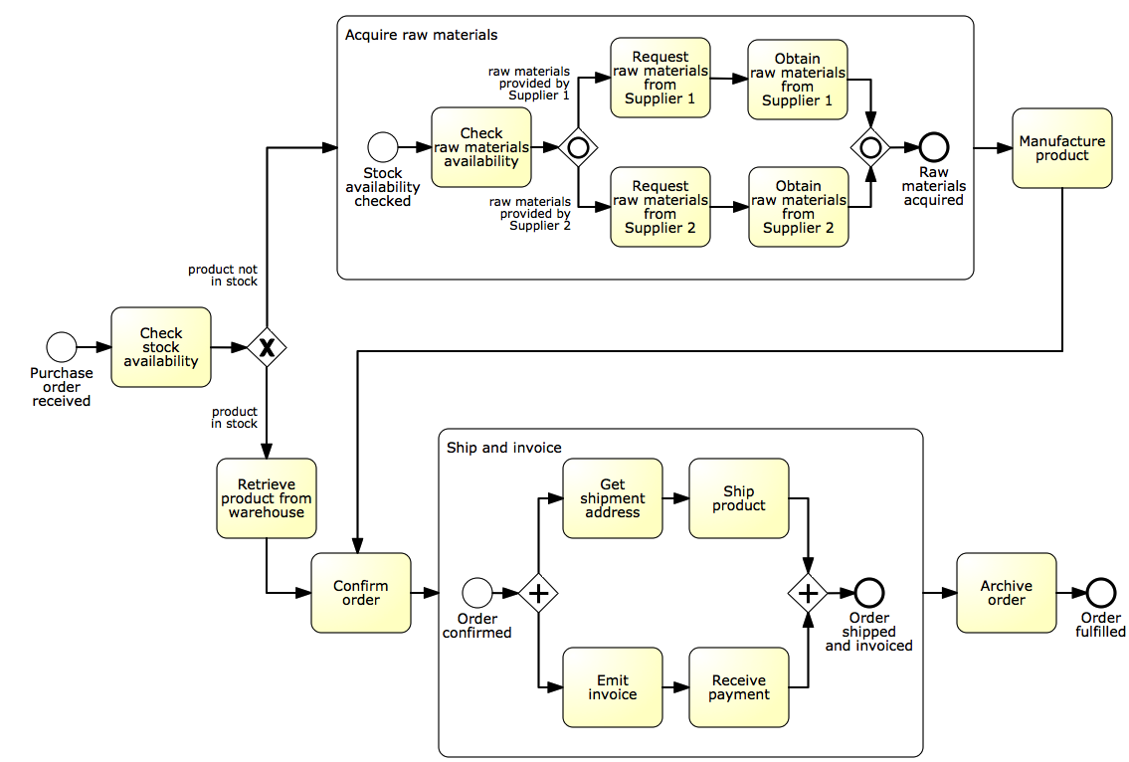
Solution

Slide 18
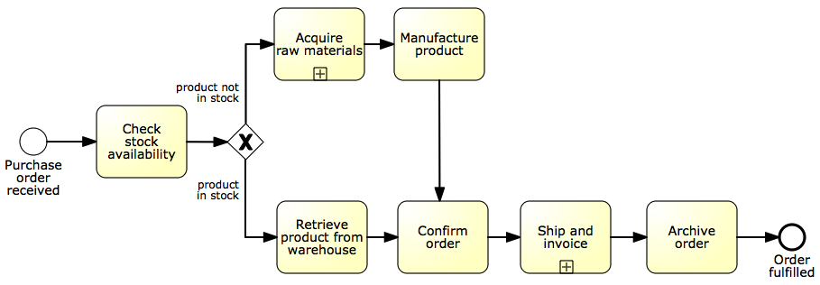
The refactored model

Slide 19
Question
When should we decompose a process model into sub-processes?
When the model becomes too large:
Hard to understand
Increased error probability
Rule of thumb: no more than 30 flow objects (activities, events, gateways)

Slide 20


Process Reuse
By default, a sub-process is “embedded” into its parent process (i.e. it is stored within the same file)
In order to maximize reuse, it is possible to “extract” the sub-process and store it as a separate file in the process model repository
Such a sub-process is called “global” model, and is invoked via a “call” activity (represented with a thicker border)
(normal)
activity
Call activity

Slide 21
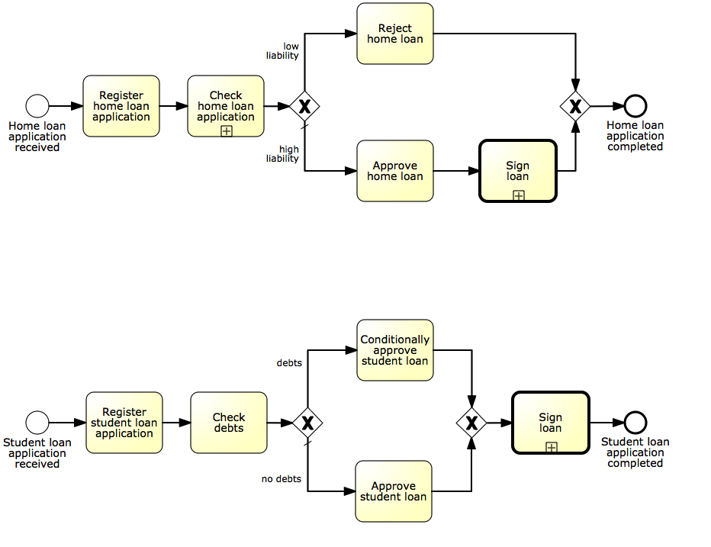

Example: process reuse
Call activity is the default choice to maximize reusability

Slide 22
Syntactical rules for sub-processes
Start with at least one start event
If multiple, first occurring will trigger the sub-process
Finish with at least one end event
The sub-process will complete once all tokens have reached an end event. May need an (X)OR-split after sub-process to understand what end event(s) have been reached
Sequence flows cannot cross sub-process boundaries
Use start/end events
Message flows can cross sub-process boundaries
To indicate messages emanating from/incoming into the sub-process

Slide 23
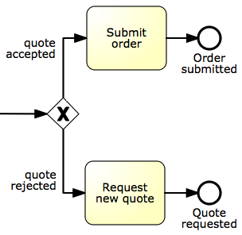
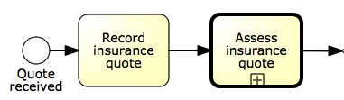
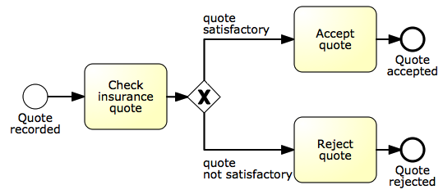
Example: sub-process with multiple end events

Slide 24
Arbitrary cycles
A cycle is a flow that goes back to an “earlier” point of the process.
Used to model parts of the process that can be repeated.
Example: address ministerial correspondence
The Finalise Ministerial Response sub-process includes the preparation of the Ministerial Response and the Review of the Response by the Principal Registrar. If the Registrar does not approve the Response, the latter needs to be prepared again for review. The process finishes only once the Response has been approved.
XOR-join: entry point
XOR-split: exit point

Slide 25
Arbitrary cycles (cont’ed)
Arbitrary = unstructured, i.e. it can have multiple entry and exit points
entry point
entry point
exit point
exit point

Slide 26
Block-structured Repetition: Activity Loop
In WF-Nets and EPCs repetitions are captured via arbitrary cycles.
BPMN also provides the Activity Loop construct, which allows the repetition of a task or sub-process
The main difference is that the Activity Loop is structured, while arbitrary cycles can be unstructured
Suggestion: use Activity Loop when your repetition is structured

Slide 27

Example: block-structured repetition
Must have a decision activity

Slide 28
Parallel Repetition: Multi-Instance activity
The multi-instance activity provides a mechanism to indicate that an activity is executed multiple times concurrently
Useful when the same activity needs to be executed for multiple entities or data items, such as:
Request quotes from multiple suppliers
Check the availability for each line item in an order separately
Send and gather questionnaires for multiple witnesses in the context of an insurance claim

Slide 29
Example: multi-instance activity
In procurement, typically a quote is to be obtained from all preferred suppliers (assumption: five preferred suppliers exist). After all quotes are received, they are evaluated and the best quote is selected. A corresponding purchase order is then placed.

Slide 30
Solution: without multi-instance activity

Slide 31
Solution: with multi-instance activity
cardinality

Slide 32
Example: multi-instance activity
After a car accident, a statement is sought from the witnesses that were present, in order to lodge the insurance claim. As soon as the first two statements are received, the claim can be lodged to the insurance company without waiting for the other statements.
PS: all people involved in the accident survived!

Slide 33
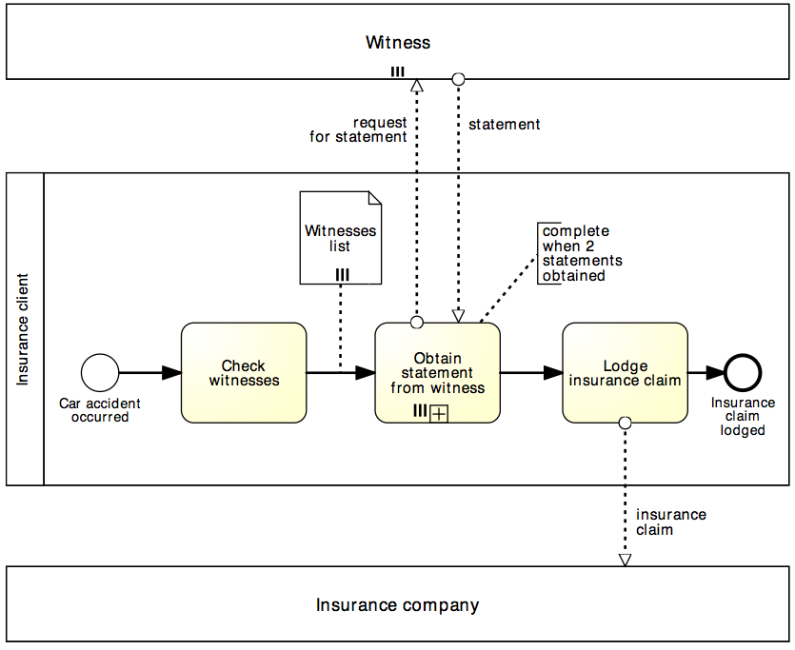
Solution: multi-instance activity
multi-instance pool
denotes multiple participants of the same type
data collection denotes a set of data objects of the same type
completion condition indicates minimum number of instances required to complete
(≤ cardinality)

Slide 34
Uncontrolled Repetition: Ad-hoc sub-process
The ad-hoc sub-process contains activities (tasks or sub-processes) to be executed in arbitrary order and time
May define order of sub-set of activities by sequence flow
Can be used in an early version of a process diagram when the order of execution is still unknown
Denoted with a tilde marker

Slide 35
Example: ad-hoc sub-process
A typical army selection process starts by shortlisting all candidates’ applications. Those shortlisted are then called to sit the following tests: drug and alcohol, eye, color vision, hearing, blood, urine, weight, fingerprinting and doctor examination. The color vision can only be done after the eye test, while the doctor examination can only be done after color vision, hearing, blood, urine and weight have been tested. Moreover, it may be required for some candidates to repeat some of these tests multiple times in order to get a correct assessment, e.g. the blood test may need be repeated if the candidate has taken too much sugar in the previous 24 hours. The candidates that pass all tests are asked to sit a mental exam and a physical exam, followed by an interview. Only those that also pass these two exams and perform well in the interview can be recruited in the army.

Slide 36
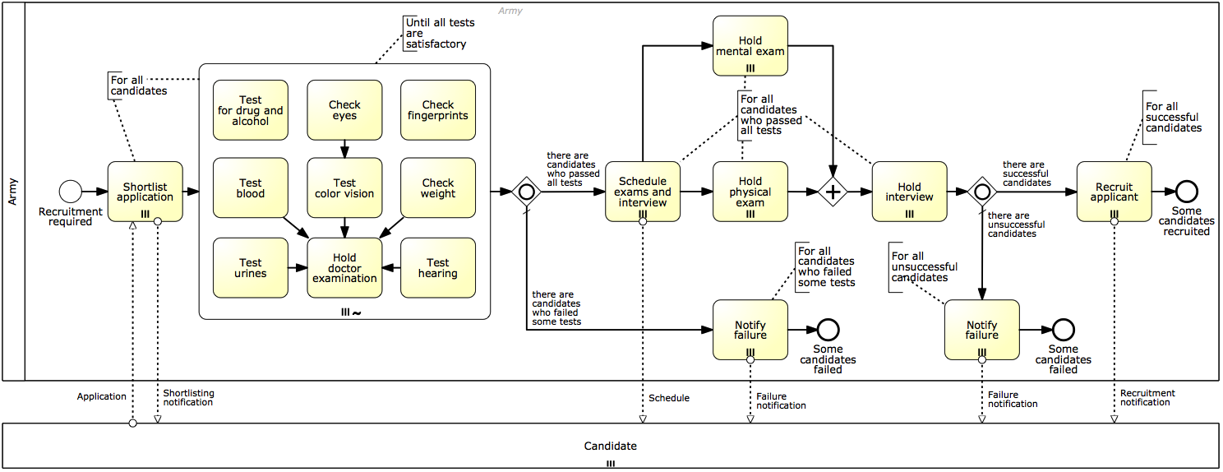
Solution: ad-hoc sub-process

Slide 37

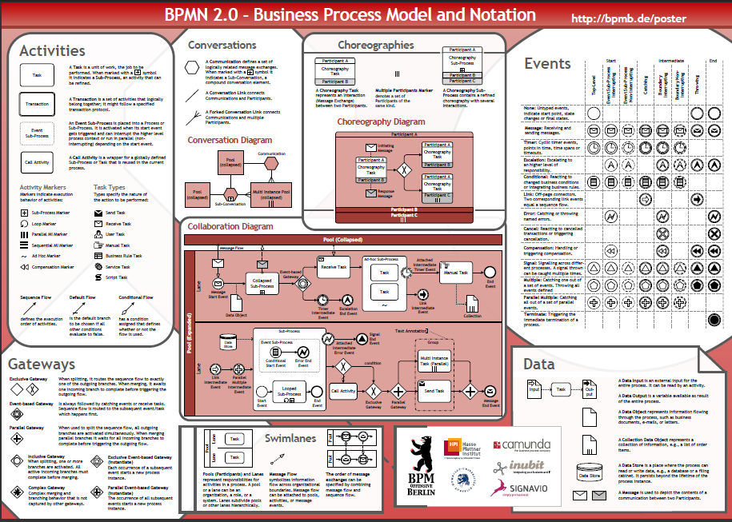
BPMN Poster: get it from blackboard!

Slide 38
References
Required
Sections 4.1 - 4.3.1 of Chapter 4 of textbook “Fundamentals of BPM”
Recommended
OMG (2011): BPMN 2.0 Specification
BPM Offensive (2011): BPMN 2.0 Poster
OGM (2010): BPMN 2.0 By Example
Web References
OMG BPM Initiative
BPMN Community
Books on BPMN
Silver B. (2011): “BPMN Method & Style” 2nd Edition, Cody-Cassidy

Slide 39


A/Prof. Marcello La Rosa BPM Discipline Information Systems School Science & Engineering Faculty Queensland University of Technology P block, GP campus Brisbane QLD 4000 Australia
p +61 (0)7 3138-9482 e m.larosa@qut.edu.au w www.marcellolarosa.com

